Slide 1
Git Branching Example
Created on Win7 Laptop: 11/25/2016

Slide 2
Background
Before branching, the content was a series of text files that would not have completely matched Markdown format
After branching, edits were made to all content text files to create a first draft that should be valid markdown syntax. All files were also changed from .txt to .md
These slides show commands to set up the branch and switch between branches and illustrate these differences
Finally – slides show the commands to merge the branches thus replacing original .txt draft with newer branch that is .md

Slide 3
Commands to set up and switch to new branch
Mitch@Win7-PC MINGW64 ~/Documents/Git_Repo/DevEnv-SetUp-Help (master)
$ git branch
* master
Mitch@Win7-PC MINGW64 ~/Documents/Git_Repo/DevEnv-SetUp-Help (master)
$ git branch contentAsMarkdown
Mitch@Win7-PC MINGW64 ~/Documents/Git_Repo/DevEnv-SetUp-Help (master)
$ git branch
contentAsMarkdown
* master
Mitch@Win7-PC MINGW64 ~/Documents/Git_Repo/DevEnv-SetUp-Help (master)
$ git checkout contentAsMarkdown
Switched to branch 'contentAsMarkdown'

Slide 4
Git Status: Shows some of the changes made
This output of Git Status shows changes made to our files on the new branch. Status command is used after “add” but before “commit” to show what changes will be committed to the branch.
Mitch@Win7-PC MINGW64 ~/Documents/Git_Repo/DevEnv-SetUp-Help (contentAsMarkdown)
$ git status
On branch contentAsMarkdown
Changes not staged for commit:
(use "git add/rm <file>..." to update what will be committed)
(use "git checkout -- <file>..." to discard changes in working directory)
deleted: GitHub_win7/GitHub_Basic_Commands_and_ScratchNotes.txt
deleted: GitHub_win7/GitHub_Intro_GetInfo_Commands.txt
deleted: GitHub_win7/GitHub_Intro_OtherUsefulCommands.txt
deleted: GitHub_win7/GitHub_Lesson1_SetupProject.txt
deleted: GitHub_win7/GitHub_Lesson2_InitializeExistingCodeProject.txt
deleted: GitHub_win7/GitHub_Lesson3_BranchingCommands.txt
deleted: GitHub_win7/GitHub_Lesson4_UndoingMistakes.txt
deleted: GitHub_win7/GitHub_Setup-Advanced_Work-w-Multiple-User-Accounts.txt
Untracked files:
(use "git add <file>..." to include in what will be committed)
GitHub_win7/GitHub_General-ScratchNotes-and-Help-Links.md
GitHub_win7/GitHub_Intro_GetInfo_Commands.md
GitHub_win7/GitHub_Intro_OtherUsefulCommands.md
GitHub_win7/GitHub_Lesson1_SetupProject.md
GitHub_win7/GitHub_Lesson2_InitializeExistingCodeProject.md
GitHub_win7/GitHub_Lesson3_BranchingCommands.md
GitHub_win7/GitHub_Lesson4_UndoingMistakes.md
GitHub_win7/GitHub_Setup-Advanced_Work-w-Multiple-User-Accounts.md
no changes added to commit (use "git add" and/or "git commit -a")

Slide 5
Git Status: Shows some of the changes made
After more editing … note that we change .gitignore file adding “~*.* so Git will ignore temp files from Microsoft Office
Mitch@Win7-PC MINGW64 ~/Documents/Git_Repo/DevEnv-SetUp-Help (contentAsMarkdown)
$ git branch
* contentAsMarkdown
master
Mitch@Win7-PC MINGW64 ~/Documents/Git_Repo/DevEnv-SetUp-Help (contentAsMarkdown)
$ git status
On branch contentAsMarkdown
Untracked files:
(use "git add <file>..." to include in what will be committed)
GitHub_win7/Git Branching Example - Lesson3.pptx
GitHub_win7/~$Git Branching Example - Lesson3.pptx
nothing added to commit but untracked files present (use "git add" to track)
Mitch@Win7-PC MINGW64 ~/Documents/Git_Repo/DevEnv-SetUp-Help (contentAsMarkdown)
$ git status
On branch contentAsMarkdown
Changes not staged for commit:
(use "git add <file>..." to update what will be committed)
(use "git checkout -- <file>..." to discard changes in working directory)
modified: .gitignore
Untracked files:
(use "git add <file>..." to include in what will be committed)
GitHub_win7/Git Branching Example - Lesson3.pptx
no changes added to commit (use "git add" and/or "git commit -a")

Slide 6
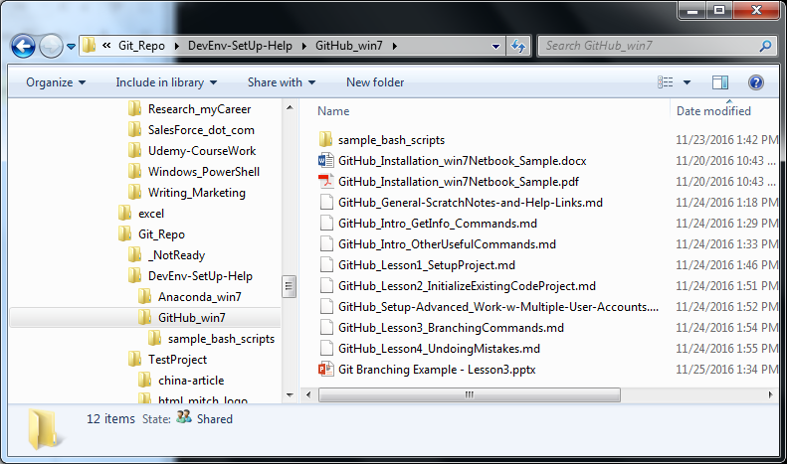
contentAsMarkDown Branch (has all working edits)
Now … use “git checkout master” to switch back to original branch …
This is just a test to illustrate the two branches

Slide 7
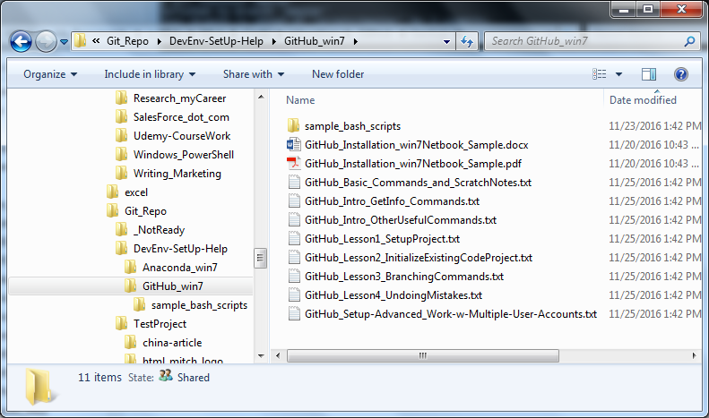
master Branch (content as it was before edits in new branch)
Now … use “git checkout contentAsMarkdown” to switch back to working branch (with all new edits) … This is just a test to illustrate the two branches

Slide 8
Merge commands in Action – Slide 1
On next slides: commands used to:
Test ahead of merging
Merge working branch back into Master
Delete the working branch once all changes are on master (and pushed up to online repo)
Process:
Make sure working branch is checked out
Merge master into working branch first (this allows you to check what the merge will look like on Master before you over-write Master branch changes with it
Checkout master branch (can only do this if all changes committed on working branch first) – this switches back to master
Perform merge on master of working branch into master
Delete working branch
Notes:
During above process, some simple bash scripts to combine adding, committing, pushing into single operations are used. UNIX list command reminds shows names of these scripts before first usage.
A copy of the bash scripts (so you can see what command syntax they contain) are immediately after the “merge commands in action” slides. Their names should give general idea of what they do.
A problem was encountered: Status revealed that hidden file Thumbs.db was edited which would have resulted in a conflict during merging. This was included in the provided command stream since it shows using “status” to detect the issue and the bash scripts to fix the issue (add / commit operations).
If status had not been used to detect the error, we would have gotten errors and then done what is shown in this command list anyway to get all updates to go through. (Initial merge would have failed, and we then would have simply performed the add / commit operations first to get it to succeed).

Slide 9
Merge commands in Action – Slide 2a
Mitch@Win7-PC MINGW64 ~/Documents/Git_Repo/DevEnv-SetUp-Help (contentAsMarkdown)
$ ls -la *.sh
-rw-r--r-- 1 Mitch 197121 308 Nov 26 12:01 Git-Commit-Local-Repo.sh
-rw-r--r-- 1 Mitch 197121 256 Nov 21 14:28 Git-Update-Online-Repo.sh
Mitch@Win7-PC MINGW64 ~/Documents/Git_Repo/DevEnv-SetUp-Help (contentAsMarkdown)
$ git status
On branch contentAsMarkdown
Changes not staged for commit:
(use "git add <file>..." to update what will be committed)
(use "git checkout -- <file>..." to discard changes in working directory)
modified: .gitignore
modified: GitHub_win7/Thumbs.db
no changes added to commit (use "git add" and/or "git commit -a")
Mitch@Win7-PC MINGW64 ~/Documents/Git_Repo/DevEnv-SetUp-Help (contentAsMarkdown)
$ ./Git-Commit-Local-Repo.sh 'finalizing .gitignore and Thumbs.db ahead of merging'
On branch contentAsMarkdown
Changes to be committed:
(use "git reset HEAD <file>..." to unstage)
modified: .gitignore
modified: GitHub_win7/Thumbs.db
[contentAsMarkdown 57d410a] finalizing .gitignore and Thumbs.db ahead of merging
2 files changed, 4 insertions(+)
commit 57d410af1087cea15200128a8ca59fd95ec1804c
Author: <author info provided here>
Date: Sat Nov 26 12:03:04 2016 -0500
finalizing .gitignore and Thumbs.db ahead of merging
Mitch@Win7-PC MINGW64 ~/Documents/Git_Repo/DevEnv-SetUp-Help (contentAsMarkdown)
$ git status
On branch contentAsMarkdown
nothing to commit, working tree clean
Mitch@Win7-PC MINGW64 ~/Documents/Git_Repo/DevEnv-SetUp-Help (contentAsMarkdown)
$ git merge master
Already up-to-date.
Mitch@Win7-PC MINGW64 ~/Documents/Git_Repo/DevEnv-SetUp-Help (contentAsMarkdown)
$ git checkout master
Switched to branch 'master'
Your branch is ahead of 'origin/master' by 3 commits.
(use "git push" to publish your local commits)
Mitch@Win7-PC MINGW64 ~/Documents/Git_Repo/DevEnv-SetUp-Help (master)
$ git branch
contentAsMarkdown
* master
Mitch@Win7-PC MINGW64 ~/Documents/Git_Repo/DevEnv-SetUp-Help (contentAsMarkdown)
$ git checkout master
Switched to branch 'master'
Your branch is ahead of 'origin/master' by 3 commits.
(use "git push" to publish your local commits)
Mitch@Win7-PC MINGW64 ~/Documents/Git_Repo/DevEnv-SetUp-Help (master)
$ git branch
contentAsMarkdown
* master

Slide 10
Merge commands in Action – Slide 2b
Mitch@Win7-PC MINGW64 ~/Documents/Git_Repo/DevEnv-SetUp-Help (master)
$ git merge contentAsMarkdown
Updating 83bd28c..57d410a
Fast-forward
.gitignore | 5 +
GitHub_win7/Git Branching Example - Lesson3.pptx | Bin 0 -> 258160 bytes
.../GitHub_Basic_Commands_and_ScratchNotes.txt | 224 -------------------
.../GitHub_General-ScratchNotes-and-Help-Links.md | 247 +++++++++++++++++++++
...mmands.txt => GitHub_Intro_GetInfo_Commands.md} | 40 ++--
...nds.txt => GitHub_Intro_OtherUsefulCommands.md} | 64 +++---
GitHub_win7/GitHub_Lesson1_SetupProject.md | 128 +++++++++++
GitHub_win7/GitHub_Lesson1_SetupProject.txt | 123 ----------
...itHub_Lesson2_InitializeExistingCodeProject.md} | 104 +++++----
...nds.txt => GitHub_Lesson3_BranchingCommands.md} | 75 ++++---
...takes.txt => GitHub_Lesson4_UndoingMistakes.md} | 35 +--
...etup-Advanced_Work-w-Multiple-User-Accounts.md} | 13 +-
GitHub_win7/Thumbs.db | Bin 0 -> 5632 bytes
13 files changed, 567 insertions(+), 491 deletions(-)
create mode 100644 GitHub_win7/Git Branching Example - Lesson3.pptx
delete mode 100644 GitHub_win7/GitHub_Basic_Commands_and_ScratchNotes.txt
create mode 100644 GitHub_win7/GitHub_General-ScratchNotes-and-Help-Links.md
rename GitHub_win7/{GitHub_Intro_GetInfo_Commands.txt => GitHub_Intro_GetInfo_Commands.md} (73%)
rename GitHub_win7/{GitHub_Intro_OtherUsefulCommands.txt => GitHub_Intro_OtherUsefulCommands.md} (51%)
create mode 100644 GitHub_win7/GitHub_Lesson1_SetupProject.md
delete mode 100644 GitHub_win7/GitHub_Lesson1_SetupProject.txt
rename GitHub_win7/{GitHub_Lesson2_InitializeExistingCodeProject.txt => GitHub_Lesson2_InitializeExistingCodeProject.md} (50%)
rename GitHub_win7/{GitHub_Lesson3_BranchingCommands.txt => GitHub_Lesson3_BranchingCommands.md} (68%)
rename GitHub_win7/{GitHub_Lesson4_UndoingMistakes.txt => GitHub_Lesson4_UndoingMistakes.md} (77%)
rename GitHub_win7/{GitHub_Setup-Advanced_Work-w-Multiple-User-Accounts.txt => GitHub_Setup-Advanced_Work-w-Multiple-User-Accounts.md} (62%)
create mode 100644 GitHub_win7/Thumbs.db
Mitch@Win7-PC MINGW64 ~/Documents/Git_Repo/DevEnv-SetUp-Help (master)
$ git status
On branch master
Your branch is ahead of 'origin/master' by 5 commits.
(use "git push" to publish your local commits)
Changes not staged for commit:
(use "git add <file>..." to update what will be committed)
(use "git checkout -- <file>..." to discard changes in working directory)
modified: GitHub_win7/Thumbs.db
no changes added to commit (use "git add" and/or "git commit -a")
Mitch@Win7-PC MINGW64 ~/Documents/Git_Repo/DevEnv-SetUp-Help (master)
$ ./Git-Update-Online-Repo.sh 'update hidden Thumbs.db so push will work'
On branch master
Your branch is up-to-date with 'origin/master'.
Changes to be committed:
(use "git reset HEAD <file>..." to unstage)
modified: GitHub_win7/Thumbs.db
[master fe68438] update hidden Thumbs.db so push will work
1 file changed, 0 insertions(+), 0 deletions(-)
Counting objects: 4, done.
Delta compression using up to 2 threads.
Compressing objects: 100% (4/4), done.
Writing objects: 100% (4/4), 400 bytes | 0 bytes/s, done.
Total 4 (delta 3), reused 0 (delta 0)
remote: Resolving deltas: 100% (3/3), completed with 3 local objects.
To https://github.com/TheMitchWorksPro/DevEnv-SetUp-Help
57d410a..fe68438 master -> master
Mitch@Win7-PC MINGW64 ~/Documents/Git_Repo/DevEnv-SetUp-Help (master)
$ git status
On branch master
Your branch is up-to-date with 'origin/master'.
nothing to commit, working tree clean
Mitch@Win7-PC MINGW64 ~/Documents/Git_Repo/DevEnv-SetUp-Help (master)
$ git branch -d contentAsMarkdown
Deleted branch contentAsMarkdown (was 57d410a).
Mitch@Win7-PC MINGW64 ~/Documents/Git_Repo/DevEnv-SetUp-Help (master)
$ git branch
* master

Slide 11
Merge commands in Action – Bash Script Used
# Git-Update-Online-Repo.sh
# simple bash script
# this script will add and commit all changes
# it also pushes all changes up to the online repo
# use single quotes to pass in the commit comment string as first argument
git add --all
git status
git commit -m "$*"
git push
# Git-Commit-Local-Repo.sh
# this script will add and commit all changes to local working project
# it uses status and log commands to show what is happening along the way
# use single quotes to pass in the commit comment string as first argument
git add --all
git status
git commit -m "$*"
git log -n 1

